Slide 1

UPLION: AI Gateway
Unleashing AI's power through cloud-native resilience and Kubernetes-driven scalability
Notes:
Good morning, everyone,
Today, I am excited to share with you the results of our team's efforts over the past few weeks: UPLION: An AI Gateway.

Slide 2
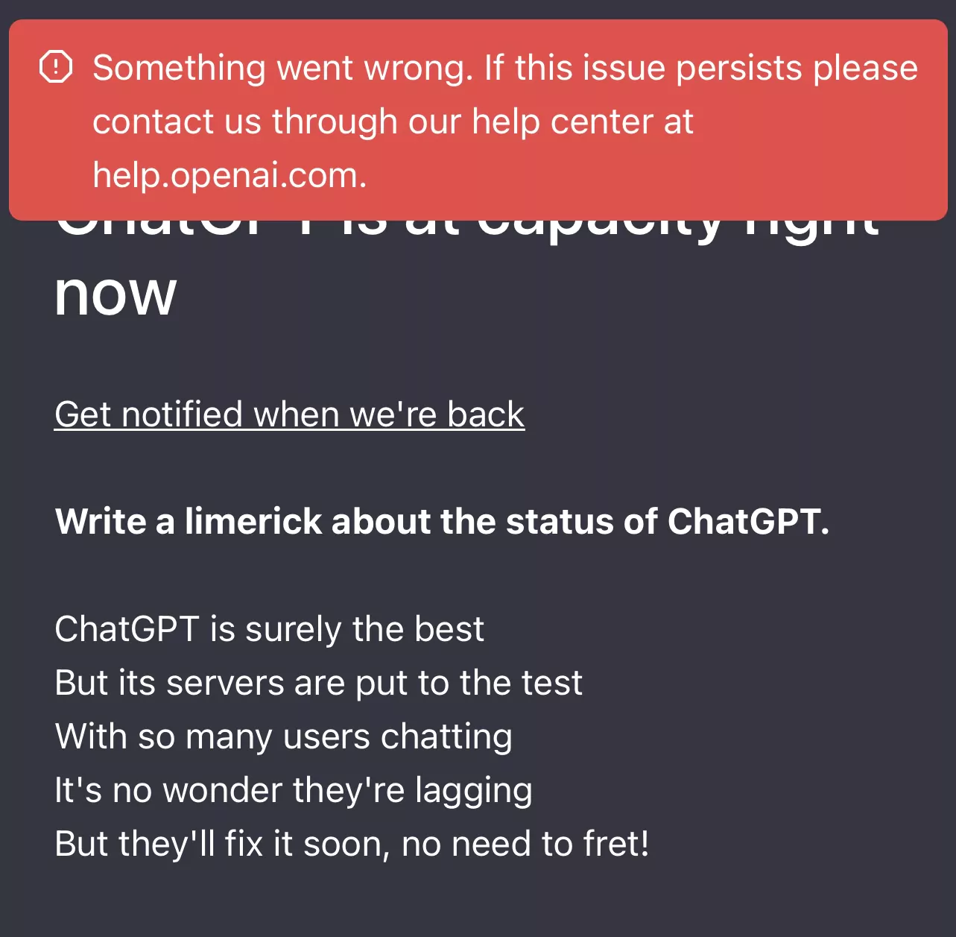
How can we build more resilient AI infrastructures?
Notes:
In the rapidly evolving world of AI services, we've all witnessed the growing pains of scaling and reliability. Remember the frustrations of last year when popular AI services like ChatGPT faced frequent downtimes? These instances highlighted a crucial question: How can we build more resilient AI infrastructures?

Slide 3

UP
L
I
O
N
Notes:
Today, I'm excited to introduce you to uplion - an experimental project that explores innovative answers to this question. Imagine you're a developer with a fine-tuned model you want to deploy, or you're looking to leverage multiple AI service accounts to increase concurrency. How would you approach building a system to handle these scenarios reliably and at scale? This is where uplion comes in.
So, what exactly is UPLION?

Slide 4

UP
Unified Platform for AI
L
Leveraging cloud-native design
I
Intelligent self-serving task distribution
O
Optimizing resource allocation
N
Natively integrated with Kubernetes
Notes:
UP stands for Unified Platform for AI. This is where the magic begins. It's a comprehensive platform designed to be the backbone of all your AI operations, making the complex world of artificial intelligence user-friendly and integrated.
"L" in Uplion stands for Leveraging cloud-native design. This means the platform is built to thrive in the cloud, ensuring it is scalable, resilient, and can be updated seamlessly.
"I" stands for Intelligent self-serving task distribution. Uplion allocates tasks efficiently across the system, making sure computational resources are used effectively and tasks are processed quickly and reliably.
"O" is for Optimizing resource allocation. The platform dynamically adjusts resources based on demand, ensuring you have what you need when you need it, without wasting power during quieter times.
"N" stands for Natively integrated with Kubernetes. We don't just use basic features like seamless updates and scalability. We've gone further by creating a Custom Resource Definition (CRD) and a specialized operator to implement custom logic tailored to our needs.

Slide 5

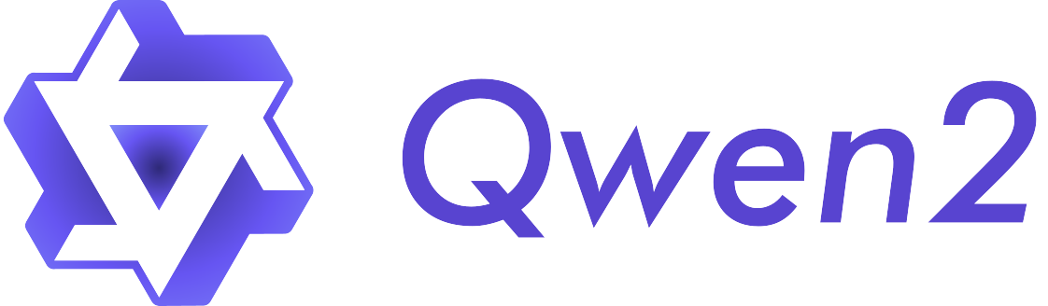
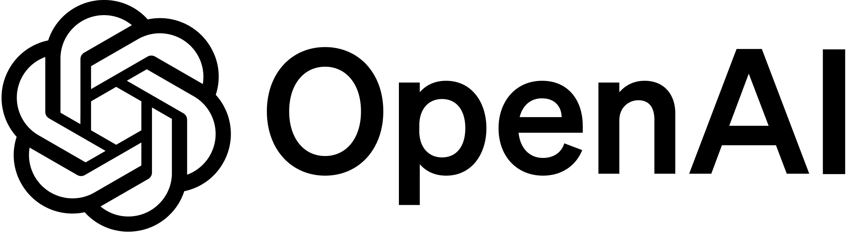
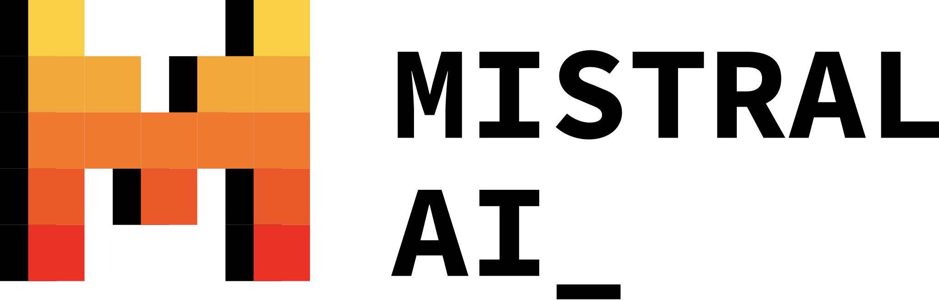


Unified Platform for AI
Leveraging
cloud-native design
Notes:
At its core, UPLION is crafted to provide AI API services. It offers the flexibility to deploy any model you choose—be it local models or remote APIs. This versatility ensures that organizations can seamlessly integrate their own finely-tuned models or utilize external AI capabilities as needed.

Slide 6
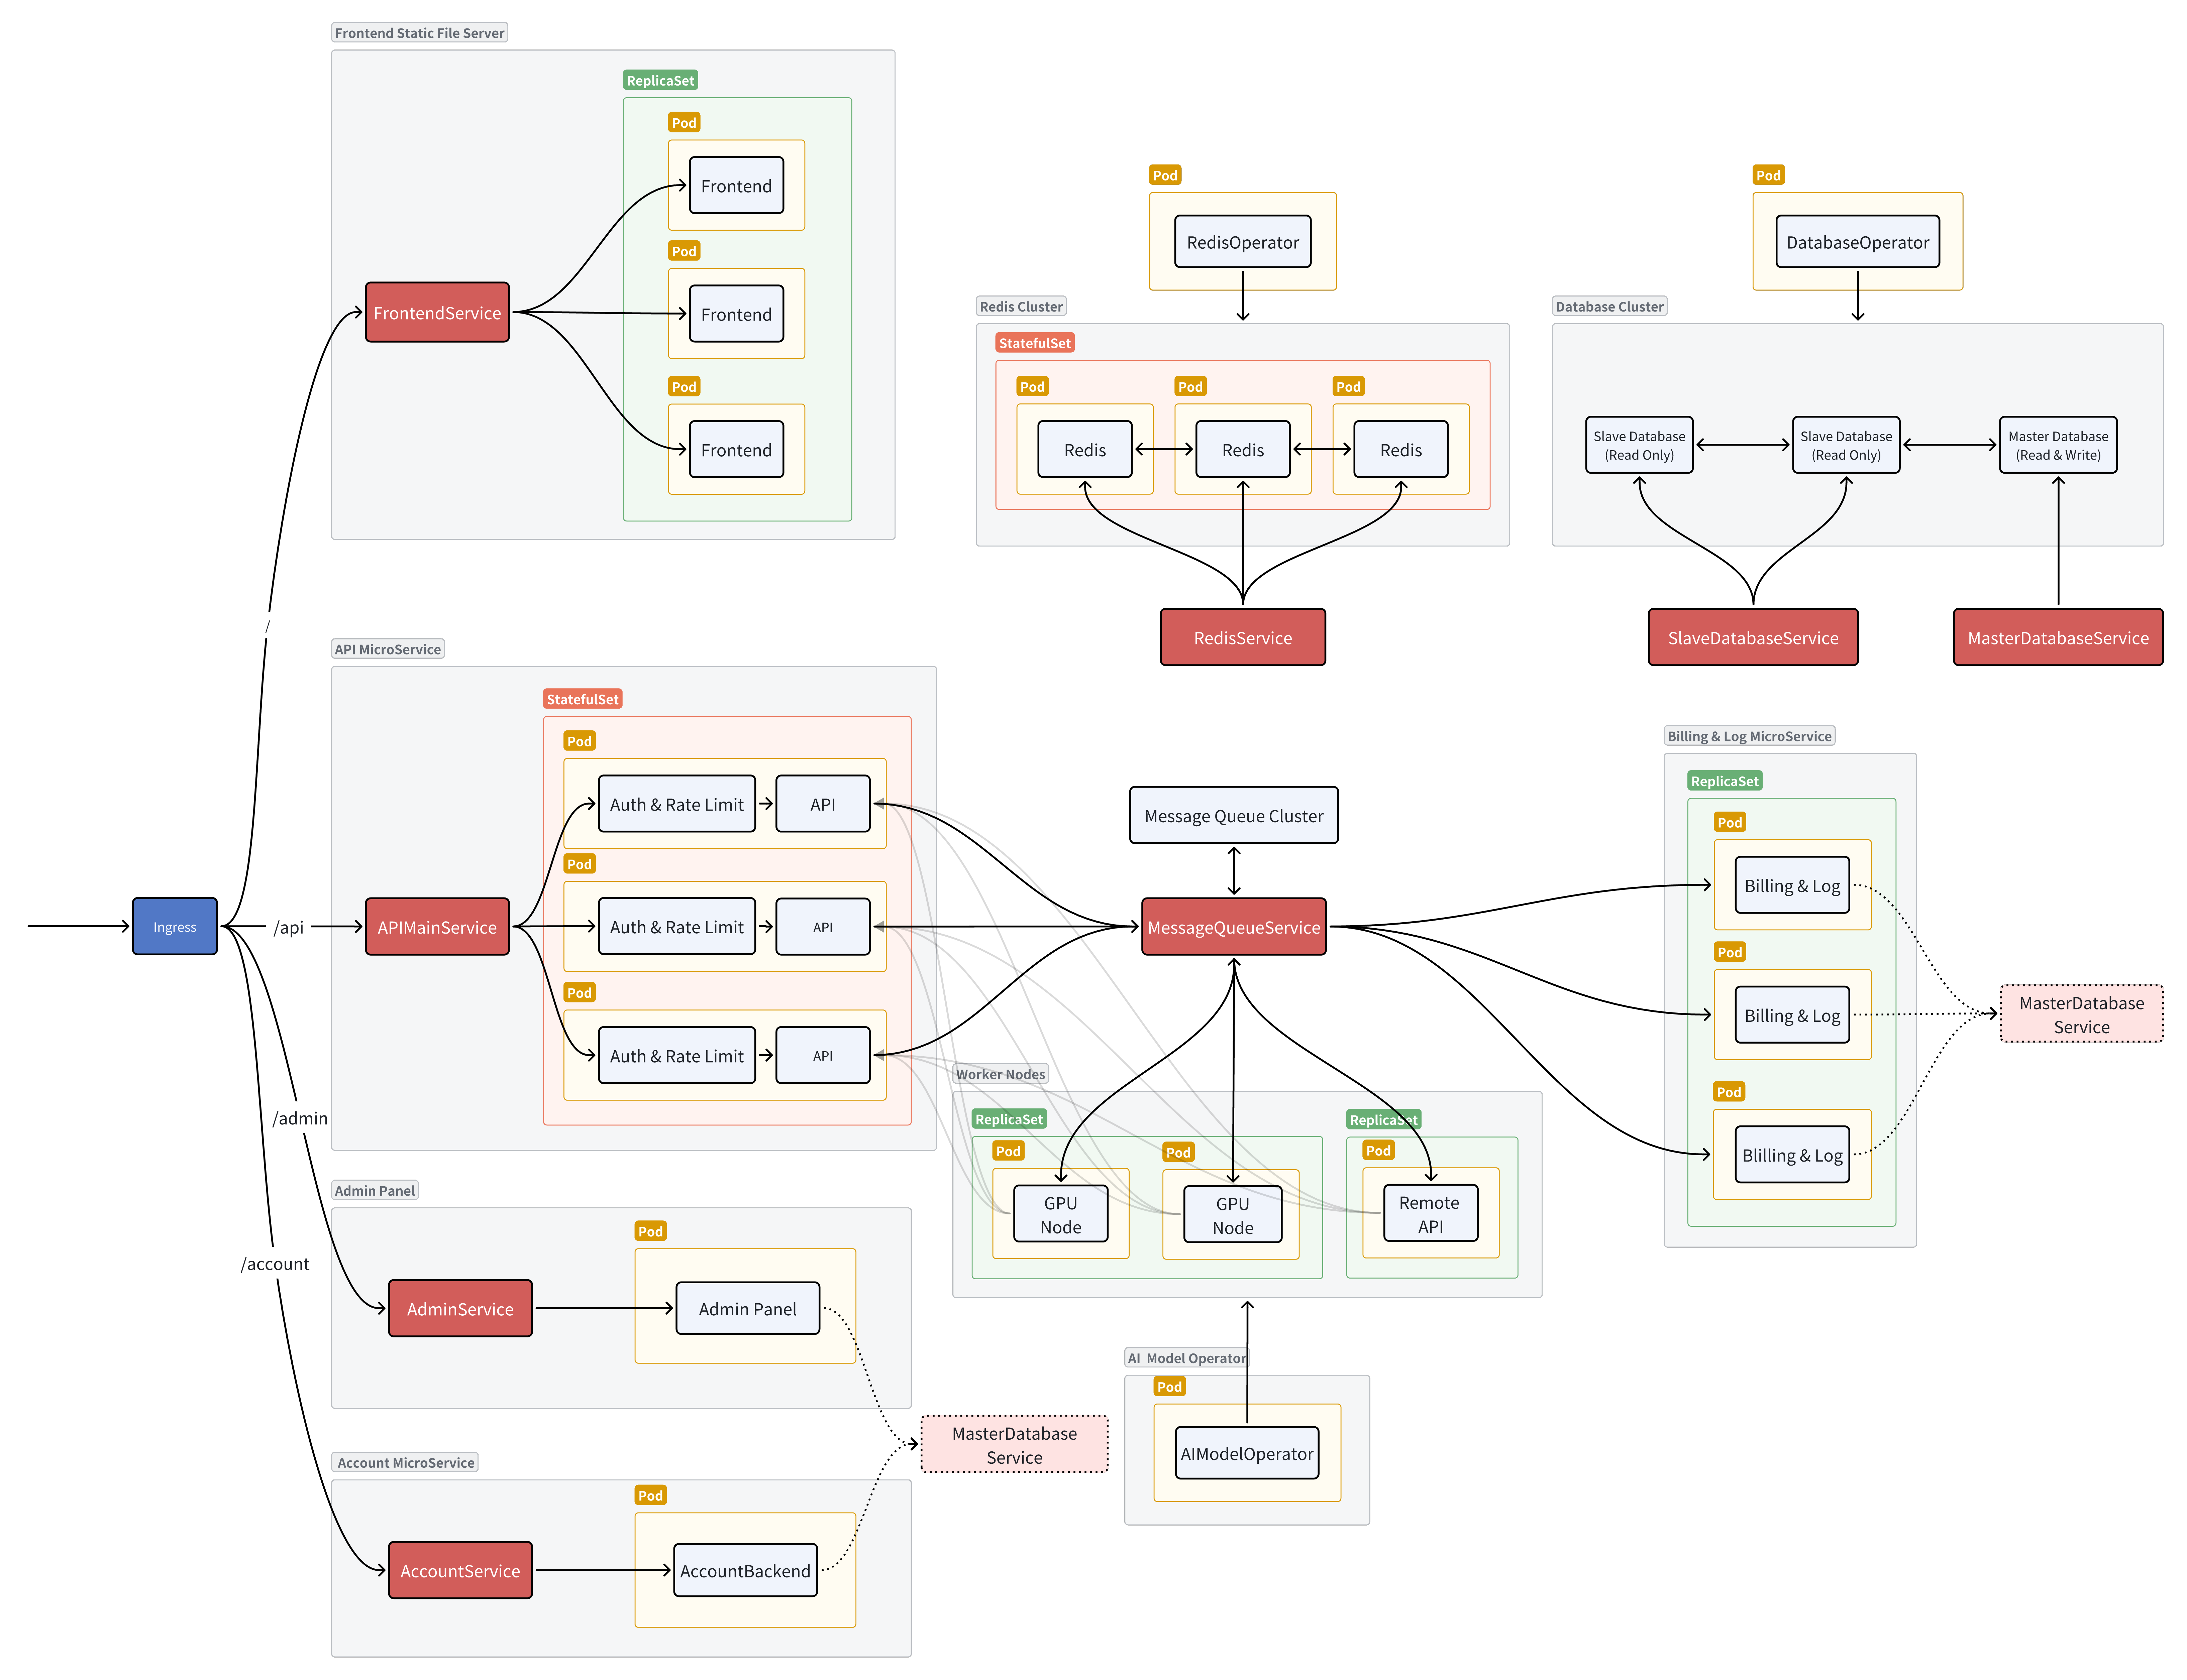
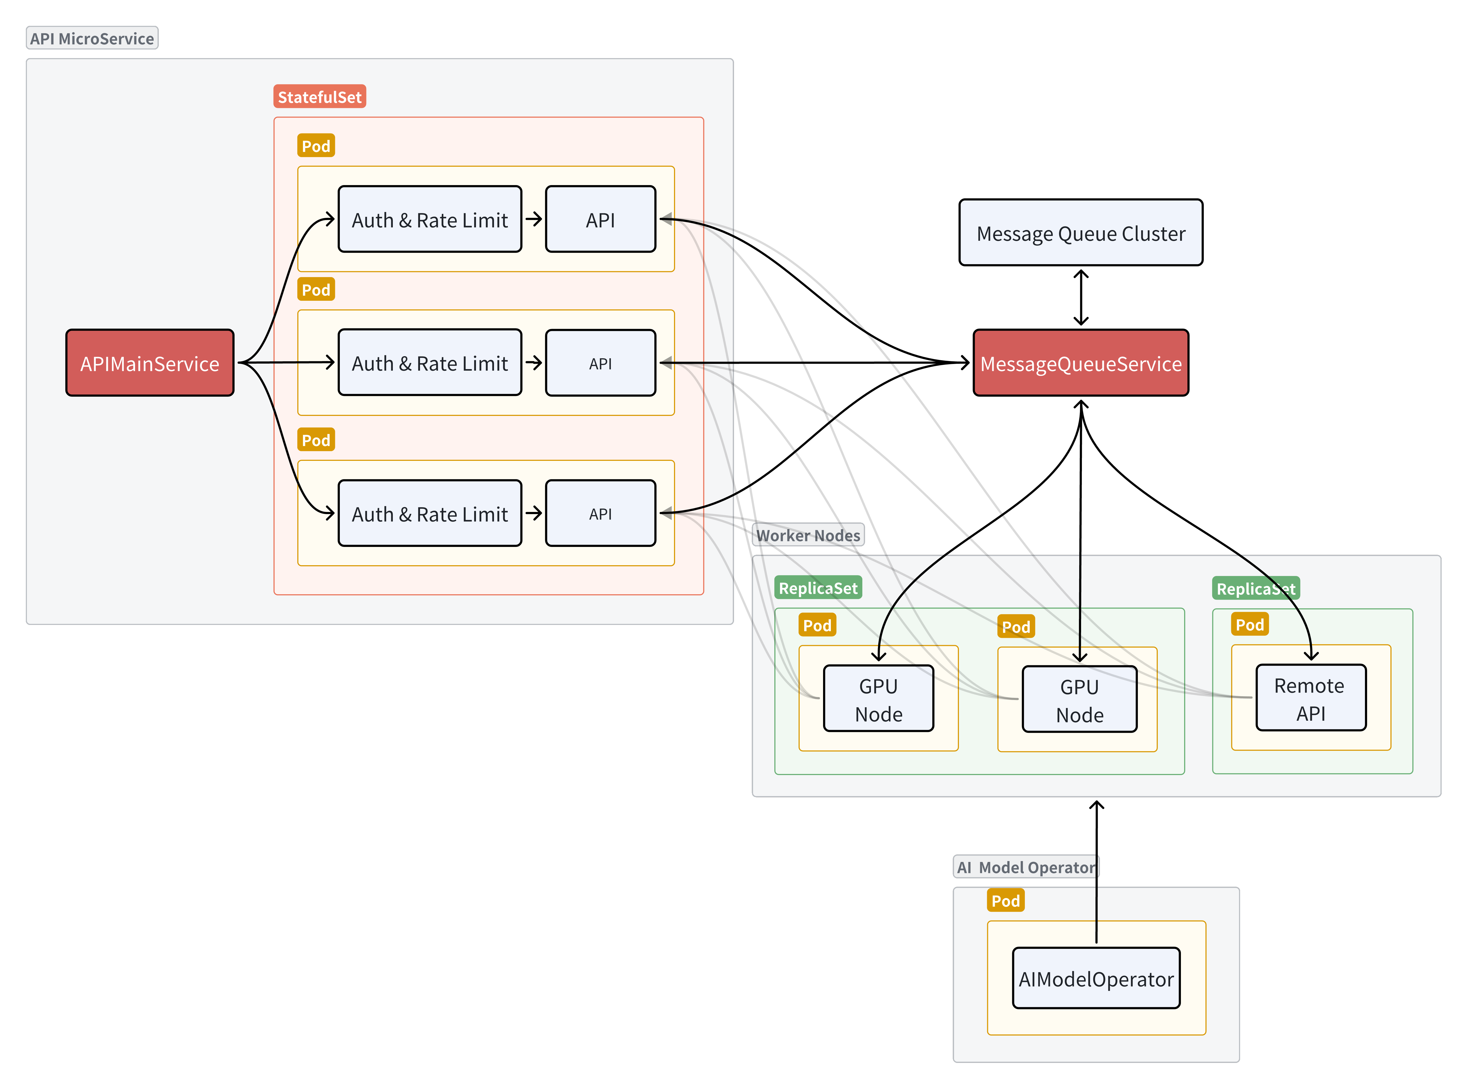
Unified Platform for AI
Leveraging
cloud-native design
key components
API main service
message queue
worker nodes
AI model operator
Notes:
Moving on to the cloud-native design aspect, let's delve into its specific architecture.

Slide 7
Leveraging
cloud-native design
Req
key components
Res
Main API service
message queue
worker nodes
AI model operator
Authentication and Rate Limiting Services
These services act as middleware that processes requests before they reach the API node. They verify whether the request carries a valid token, check if the rate limits are within acceptable bounds, and determine if quotas have been exhausted. This part primarily involves reading from the database, with almost all data being cacheable via Redis.
Notes:
At the heart of UPLION are several key components: the main-api-service, a message queue, worker nodes, and an AI model operator. The AI model operator plays a crucial role in managing the worker nodes, which I will elaborate on shortly.
Consider a scenario where a client sends an API request. (CLICK) This request is first processed by the main-api-service**(CLICK)** , which then packages the data and places it into the message queue, under a topic that corresponds to the model name.(CLICK) If a worker node is available and it's configured to handle this particular model, it retrieves the task from the queue,(CLICK) processes it, and sends the results back to the main-api-service. Throughout this process, the client maintains a connection with the API node. Once the API node receives the response from the worker node, (CLICK) it relays this information back to the client.
This setup forms the core architecture of UPLION, but there are additional services designed to enhance functionality:

Slide 8
Leveraging
cloud-native design
Authentication and Rate Limiting Services
key components
These services act as middleware that processes requests before they reach the API node. They verify whether the request carries a valid token, check if the rate limits are within acceptable bounds, and determine if quotas have been exhausted. This part primarily involves reading from the database, with almost all data being cacheable via Redis.
API main service
message queue
worker nodes
AI model operator
Frontend
Similar to interfaces like ChatGPT, the frontend is designed for ease of use, allowing users to interact smoothly with the system.
Notes:
Authentication and Rate Limiting Services: These services act as middleware that processes requests before they reach the API node. They verify whether the request carries a valid token, check if the rate limits are within acceptable bounds, and determine if quotas have been exhausted. This part primarily involves reading from the database, with almost all data being cacheable via Redis.

Slide 9
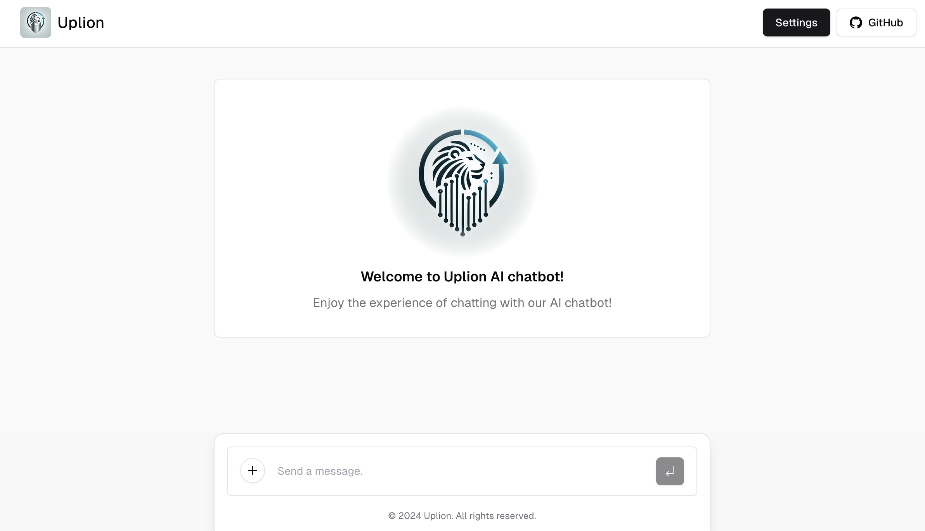
Leveraging
cloud-native design
Authentication and Rate Limiting Services
Frontend
These services act as middleware that processes requests before they reach the API node. They verify whether the request carries a valid token, check if the rate limits are within acceptable bounds, and determine if quotas have been exhausted. This part primarily involves reading from the database, with almost all data being cacheable via Redis.
Similar to interfaces like ChatGPT, the frontend is designed for ease of use, allowing users to interact smoothly with the system.
Admin Dashboard
Leveraging Kubernetes and the operator, this dashboard provides a user-friendly interface for managing worker nodes (or AI models). It also manages users and tokens.
Account Services
These services provide authentication for both the frontend and the management dashboard.
Notes:
Frontend: Similar to interfaces like ChatGPT, the frontend is designed for ease of use, allowing users to interact smoothly with the system.

Slide 10
Leveraging
cloud-native design
Similar to interfaces like ChatGPT, the frontend is designed for ease of use, allowing users to interact smoothly with the system.
Frontend
Admin Dashboard
Leveraging Kubernetes and the operator, this dashboard provides a user-friendly interface for managing worker nodes (or AI models). It also manages users and tokens.
Account Services
These services provide authentication for both the frontend and the management dashboard.
Notes:
Here's a screenshot of the front end.

Slide 11
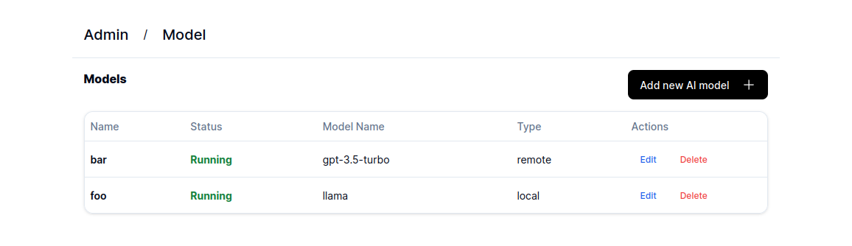
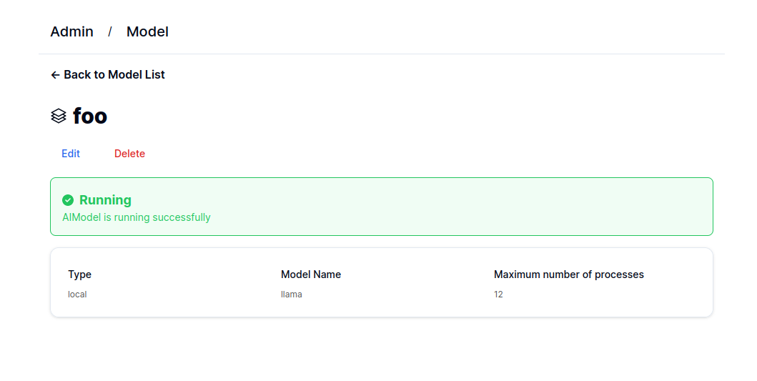
Leveraging
cloud-native design
Admin Dashboard
Frontend
Leveraging Kubernetes and the operator, this dashboard provides a user-friendly interface for managing worker nodes (or AI models). It also manages users and tokens.
Similar to interfaces like ChatGPT, the frontend is designed for ease of use, allowing users to interact smoothly with the system.
Account Services
These services provide authentication for both the frontend and the management dashboard.
Billing Service
After a worker node completes a task, it collects statistical and operational data, directing this information into a batch processing queue. The combined Billing & Log Service then aggregates these details, consolidating them into a single database write operation. This approach effectively reduces the load on the database by minimizing the frequency and volume of write requests, ensuring both efficient data handling and accurate billing records.
Notes:
Admin Dashboard: Leveraging Kubernetes and the operator, this dashboard provides a user-friendly interface for managing worker nodes (or AI models). It also manages users and tokens.
Account Services: These services provide authentication for both the frontend and the admin dashboard.

Slide 12
Leveraging
cloud-native design
Leveraging Kubernetes and the operator, this dashboard provides a user-friendly interface for managing worker nodes (or AI models). It also manages users and tokens.
Admin Dashboard
Account Services
These services provide authentication for both the frontend and the management dashboard.
Billing Service
After a worker node completes a task, it collects statistical and operational data, directing this information into a batch processing queue. The combined Billing & Log Service then aggregates these details, consolidating them into a single database write operation. This approach effectively reduces the load on the database by minimizing the frequency and volume of write requests, ensuring both efficient data handling and accurate billing records.
Notes:
Here're screenshots of the admin dashboard.

Slide 13
Leveraging
cloud-native design
Billing Service
Admin Dashboard
Leveraging Kubernetes and the operator, this dashboard provides a user-friendly interface for managing worker nodes (or AI models). It also manages users and tokens.
After a worker node completes a task, it collects statistical and operational data, directing this information into a batch processing queue. The combined Billing & Log Service then aggregates these details, consolidating them into a single database write operation. This approach effectively reduces the load on the database by minimizing the frequency and volume of write requests, ensuring both efficient data handling and accurate billing records.
Account Services
These services provide authentication for both the frontend and the management dashboard.
Storage and Message Queue
We utilize a PostgreSQL database cluster for our primary storage needs due to its robustness and reliability. It‘s important to note that throughout the entire API request process, there is no need to write to the database, ensuring that request concurrency and latency are not adversely affected. For message queuing, we use Pulsar.
Notes:
Billing Service: After a worker node completes a task, it places statistical information into a batch processing queue. The billing services combine this data and merge it into one database write request, greatly reducing database load.

Slide 14
Intelligent self-serving task distribution
Leveraging
cloud-native design
Billing Service
Storage and Message Queue
After a worker node completes a task, it collects statistical and operational data, directing this information into a batch processing queue. The combined Billing & Log Service then aggregates these details, consolidating them into a single database write operation. This approach effectively reduces the load on the database by minimizing the frequency and volume of write requests, ensuring both efficient data handling and accurate billing records.
We utilize a PostgreSQL database cluster for our primary storage needs due to its robustness and reliability. It‘s important to note that throughout the entire API request process, there is no need to write to the database, ensuring that request concurrency and latency are not adversely affected. For message queuing, we use Pulsar.
Notes:
We use a Postgres QL database cluster for primary storage because of its robustness and reliability. During the API request process, no database writes are needed, maintaining high concurrency and low latency. For message queuing, we use Pulsar.

Slide 15



Leveraging
cloud-native design
Intelligent self-serving task distribution
Storage and Message Queue
#1
#2
#3
We utilize a PostgreSQL database cluster for our primary storage needs due to its robustness and reliability. It‘s important to note that throughout the entire API request process, there is no need to write to the database, ensuring that request concurrency and latency are not adversely affected. For message queuing, we use Pulsar.
#0
Notes:
In traditional designs, a central master node allocates tasks to workers, but this can be complex and hard to maintain. In UPLION, we simplify this by using a message queue to decouple components. Worker nodes manage their own states and retrieve tasks from the queue based on their designated model.
This removed the need for a central coordinator. Multiple worker nodes can be created without extra adjustments. The message queue efficiently handles scaling, making the system adaptable and resource-efficient.
(CLICK) Suppose there are currently three pending tasks and three working nodes. One of the nodes has an error, while the other is operational and available. The available node will fetch a task from the message queue

Slide 16
Leveraging
cloud-native design
Intelligent self-serving task distribution
Storage and Message Queue
#2
#3
We utilize a PostgreSQL database cluster for our primary storage needs due to its robustness and reliability. It‘s important to note that throughout the entire API request process, there is no need to write to the database, ensuring that request concurrency and latency are not adversely affected. For message queuing, we use Pulsar.
#0
#1
Notes:
and start processing it. Once a node completes its task,

Slide 17
Leveraging
cloud-native design
Intelligent self-serving task distribution
Storage and Message Queue
#2
#3
We utilize a PostgreSQL database cluster for our primary storage needs due to its robustness and reliability. It‘s important to note that throughout the entire API request process, there is no need to write to the database, ensuring that request concurrency and latency are not adversely affected. For message queuing, we use Pulsar.
#1
#0
Notes:
it will continue to fetch the next task from the message queue.

Slide 18
Optimizing resource allocation
Leveraging
cloud-native design
Intelligent self-serving task distribution
Storage and Message Queue
#3
We utilize a PostgreSQL database cluster for our primary storage needs due to its robustness and reliability. It‘s important to note that throughout the entire API request process, there is no need to write to the database, ensuring that request concurrency and latency are not adversely affected. For message queuing, we use Pulsar.
#2
#1
Notes:
If no nodes are available, no tasks will be fetched from the message queue, so the tasks will remain in the queue, waiting.

Slide 19
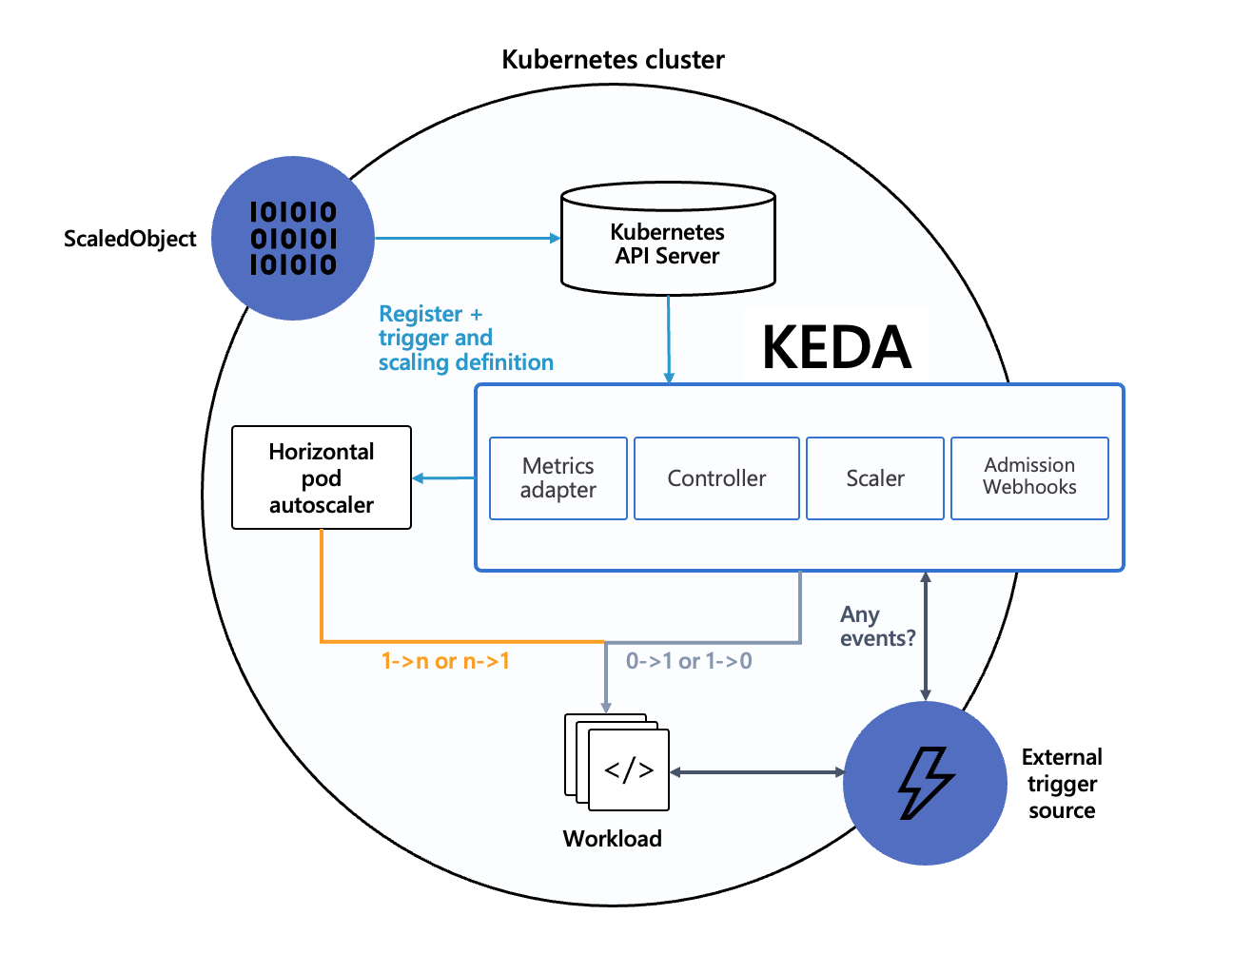
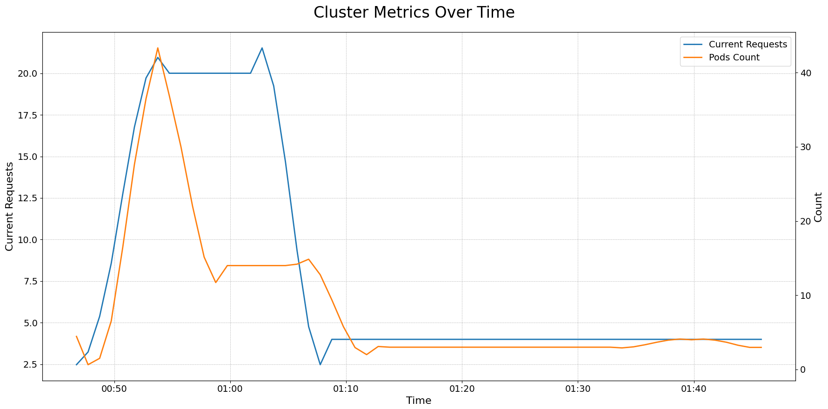
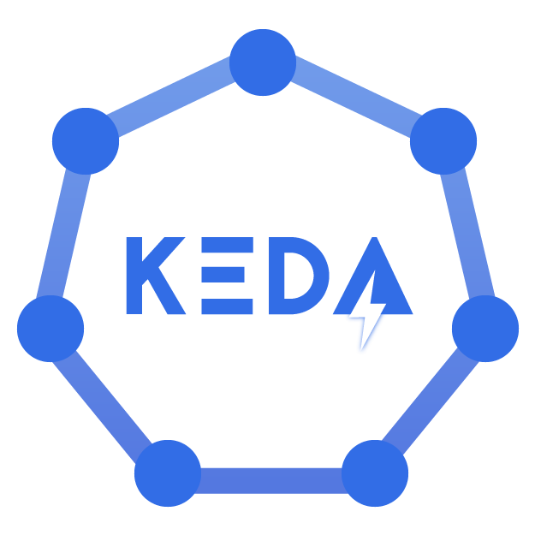
Intelligent self-serving task distribution
Optimizing resource allocation
Kubernetes Event-driven Autoscaling
Notes:
A key feature of UPLION is its automatic scalability, achieved using KEDA (Kubernetes Event-Driven Autoscaling). When an AI model is created, the operator generates a KEDA ScaledObject, prompting KEDA to create a Horizontal Pod Autoscaler (HPA). The HPA monitors the message queue, and if unprocessed messages exceed a threshold, KEDA triggers new pod creation. If the message count falls below the threshold, it reduces the pods.

Slide 20
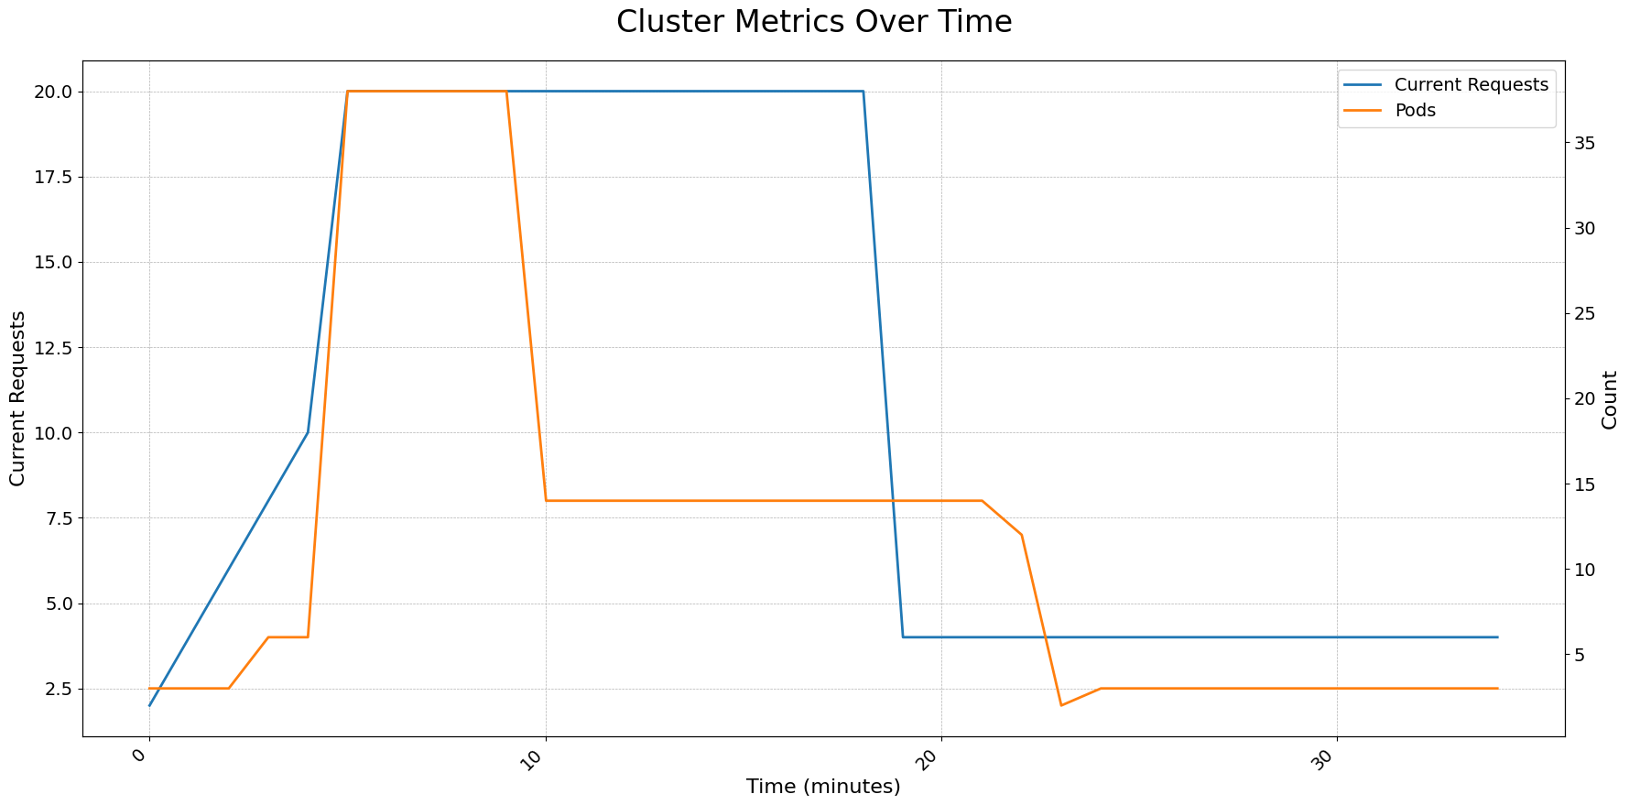
Natively Integrated with Kubernetes
Intelligent self-serving task distribution
Optimizing resource allocation
Kubernetes Event-driven Autoscaling
Notes:
We conducted a live experiment to verify its auto-scaling capabilities. In this experiment, each node was limited to handling a maximum of two requests per second. The request volume first increased and then decreased, resulting in the following chart. In this chart, the horizontal axis represents the number of minutes elapsed, the blue line indicates the number of requests per second during that minute, and the orange line shows the number of pods scaled by the system. It is evident that KEDA adjusts the resource count based on the current traffic.

Slide 21
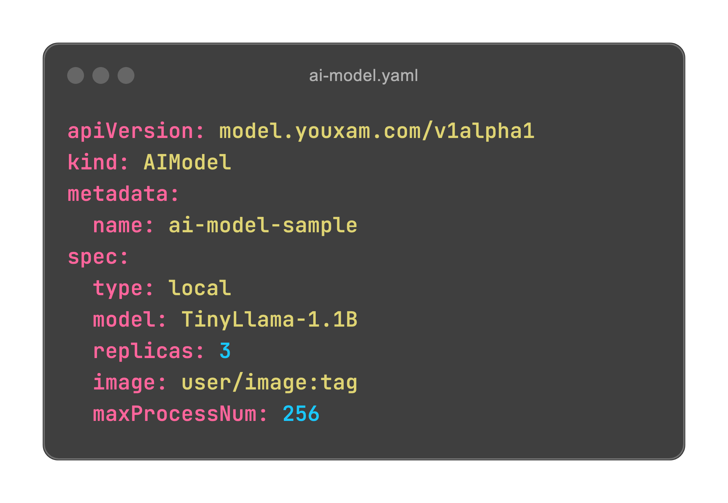
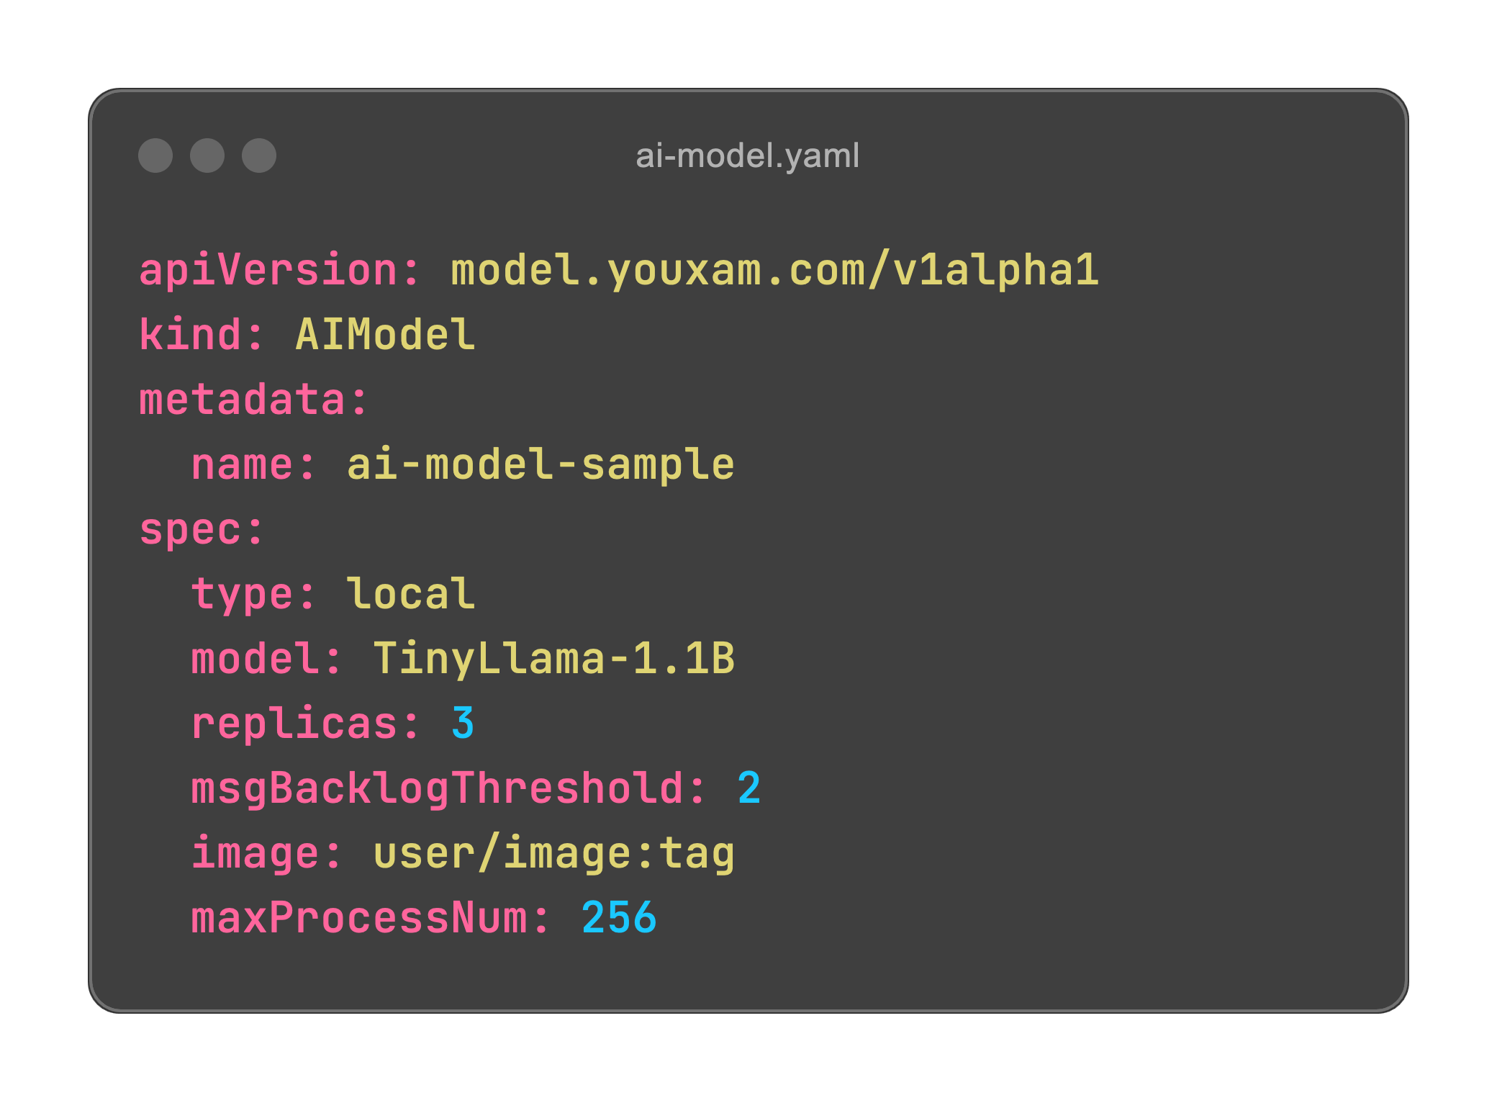
Optimizing resource allocation
Natively Integrated with Kubernetes
AI Model CRD
(Custom Resource Definition)
and
An Operator that manages it and implements its functionality
Notes:
In managing worker nodes, UPLION leverages Kubernetes with a custom "AI Model Operator." To deploy a model, you create an AI Model object with your parameters, and the operator sets up the necessary deployments and pods automatically. It also handles KEDA configuration for scaling if needed.
We use Kubernetes' event system for robust error handling. If a worker node encounters irreversible errors, it generates an event. The AI Model Operator captures this event and sets the AI Model status to 'Failed'. After correcting the configuration, the status resets to 'Running'. This integration simplifies complex AI deployments and enhances reliability, making UPLION a true Kubernetes-native solution.

Slide 22
Optimizing resource allocation
Natively Integrated with Kubernetes
AI Model CRD
(Custom Resource Definition)
and
An Operator that manages it and implements its functionality
Notes:
Including the aforementioned KEDA auto-scaling feature, it is integrated into this CRD and operator. By simply adding one line, msgBacklogThreshold, the number of replicas for this AI Model will be automatically controlled by KEDA, achieving automatic scaling based on the number of requests.

Slide 23
Optimizing resource allocation
Natively Integrated with Kubernetes
Video: https://youtu.be/KGiBRXiiWxE
Notes:
Let's watch a demonstration video. (PLAY)At the beginning, the cluster is only running the aforementioned operator, with no other applications running. (PAUSE) Now we create an AI Model CRD. (PAUSE) You can see that a corresponding deployment is created. (PAUSE) Next, we modify the replicas, (PAUSE) and you can see the number of pods changes accordingly. (PAUSE) If an irreversible error occurs, (PAUSE) you can also view the error through this AI Model CRD.

Slide 24

Technology Selection
Notes:
Now, let's discuss the technology choices that power UPLION.

Slide 25
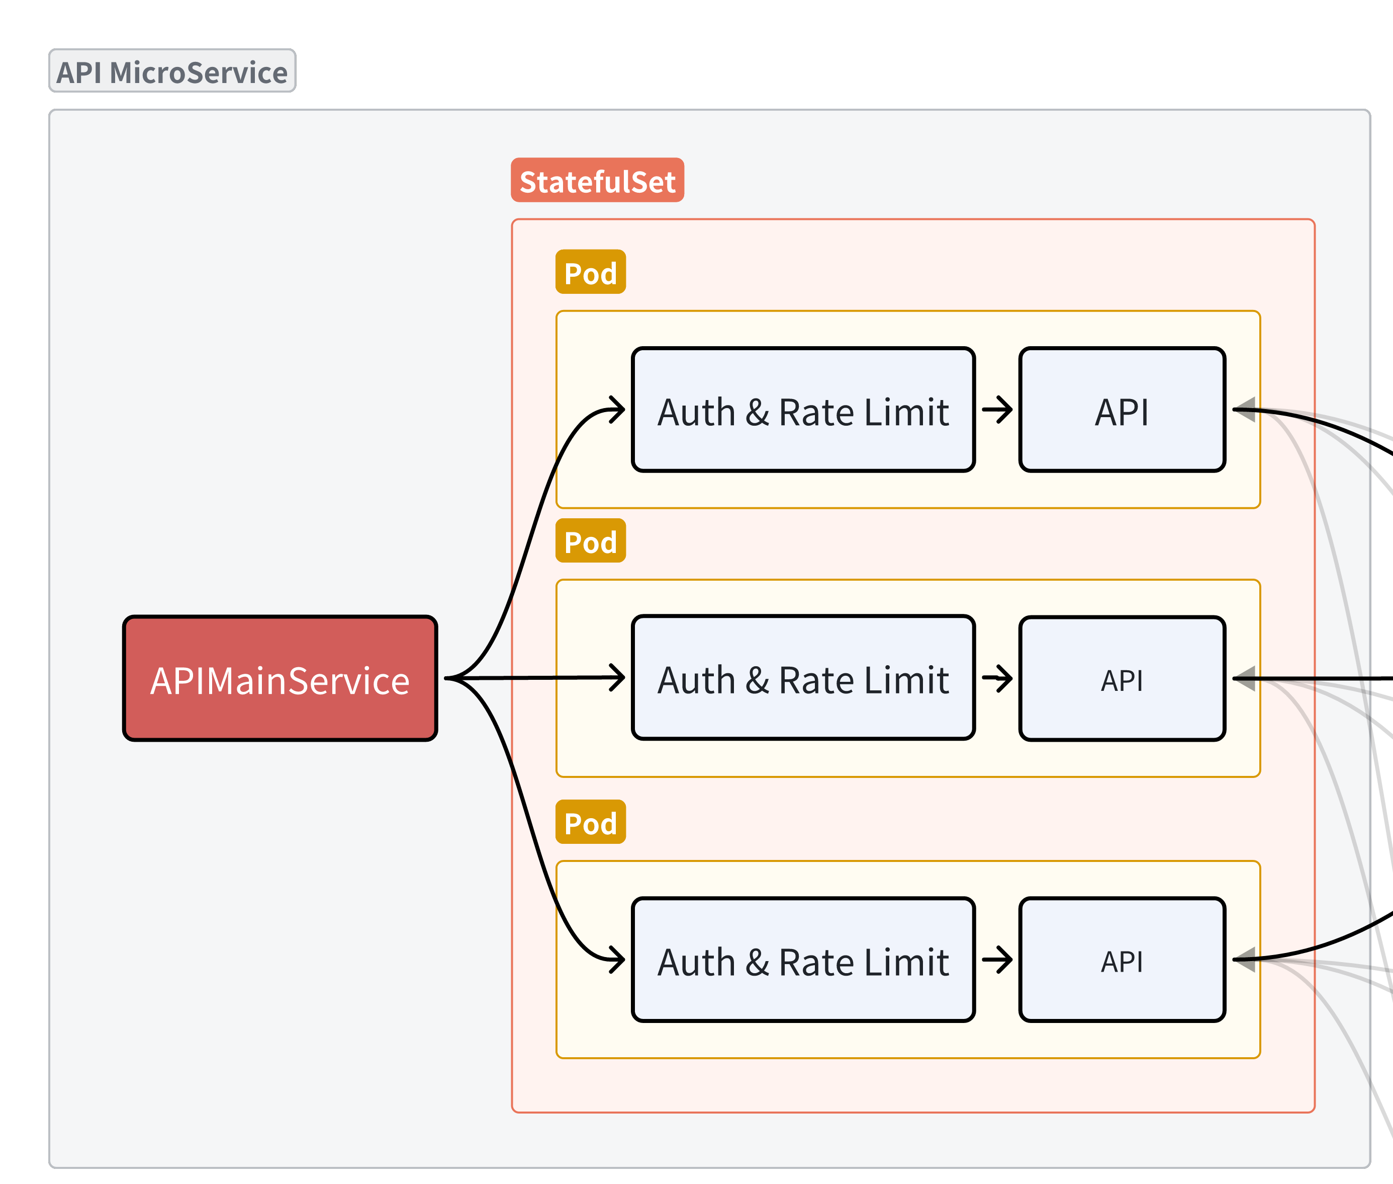

Istio
Istio extends Kubernetes to establish a programmable, application-aware network. Working with both Kubernetes and traditional workloads, Istio brings standard, universal traffic management, telemetry, and security to complex deployments.
Intercepting Requests for Middleware
Observability
Notes:
In UPLION, we employ Istio specifically to enhance our authentication and rate limiting capabilities. Here’s how Istio contributes to these areas:

Slide 26
Programming Languages
Istio
Istio extends Kubernetes to establish a programmable, application-aware network. Working with both Kubernetes and traditional workloads, Istio brings standard, universal traffic management, telemetry, and security to complex deployments.
Intercepting Requests for Middleware
Notes:
Intercepting Requests for Middleware: Istio can intercept requests before they reach the API node, extract the API token, and check its validity and quota. It also enforces rate limiting, making the logic clearer and simplifying development and deployment.

Slide 27

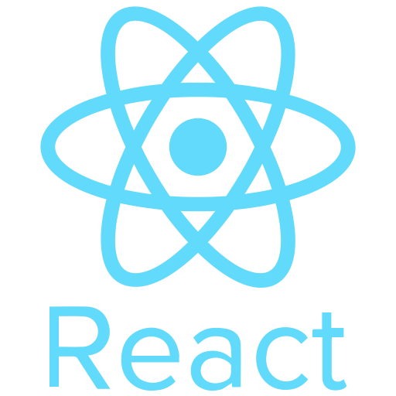
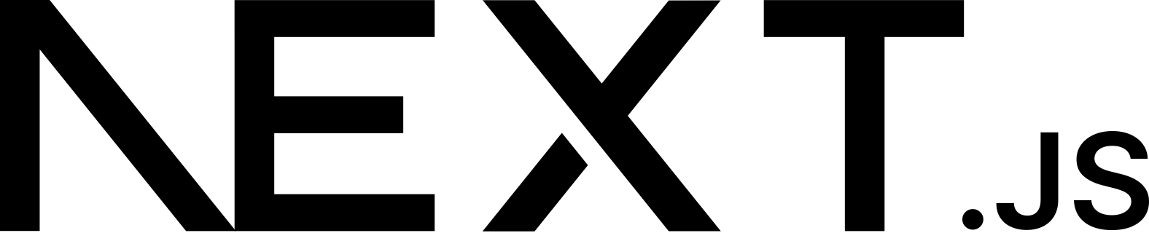
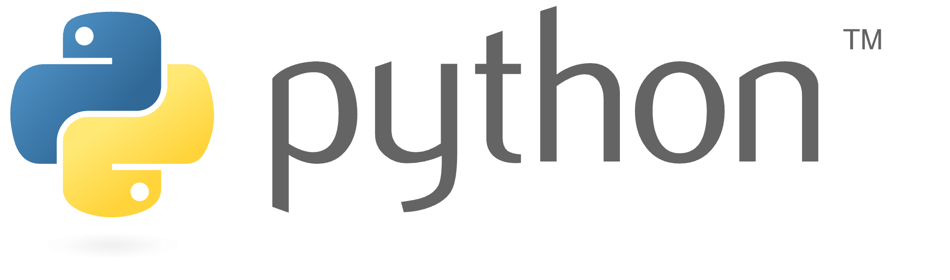
Terraform
Istio
Programming Languages
Main API Service
AI model operator
Frontend
/
Admin Dashboard
worker node
Notes:
During the development of the main-api-service and the AI model operator, we chose to use Go. The main-api-service requires high concurrency, which Go handles very efficiently. For the AI model operator, Go was chosen due to the convenience of the Operator SDK, which simplifies development considerably.
For the frontend and the admin dashboard, we used Nextjs and React. These frameworks provide robust tools for building interactive and dynamic user interfaces.
Lastly, for component like the worker node, where concurrency demands are lower, we opted for Python.

Slide 28
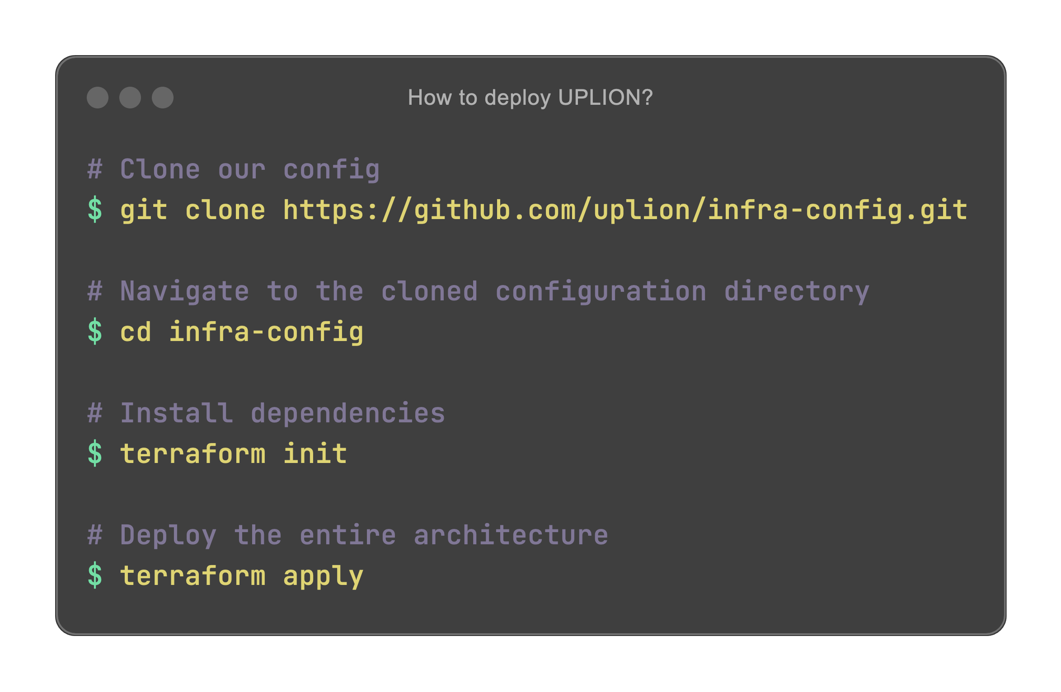
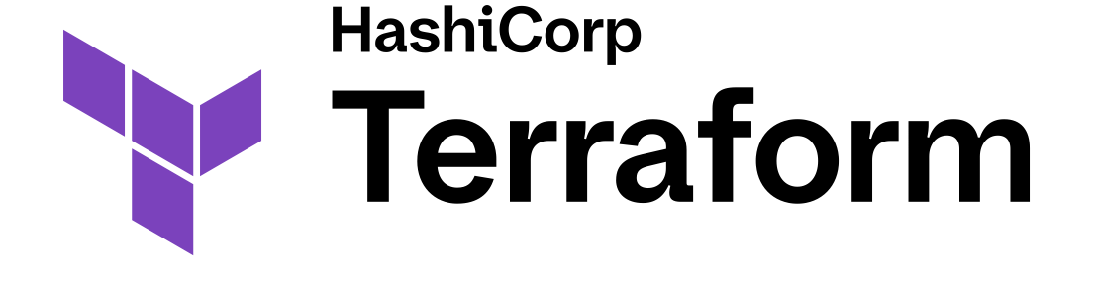
Programming Languages
Terraform
Terraform is an infrastructure as code tool that lets you build, change, and version infrastructure safely and efficiently. This includes low-level components like compute instances, storage, and networking; and high-level components like DNS entries and SaaS features.
Notes:
We use Terraform as our main tool for configuration and deployment. Terraform is an open-source infra-structure as code tool that allows users to define and provision data center infra-structure with a high-level configuration language. It supports multiple service providers like AWS, managing resources such as EKS clusters, databases, message queues, and application deployments.

Slide 29
Programming Languages
Terraform
Terraform is an infrastructure as code tool that lets you build, change, and version infrastructure safely and efficiently. This includes low-level components like compute instances, storage, and networking; and high-level components like DNS entries and SaaS features.
Notes:
To deploy the entire application from scratch, one only needs to execute two commands: `terraform init` to initialize the setup, and `terraform apply` to apply the configurations and launch the resources.
Terraform simplifies the deployment process, especially in environments like the AWS Academy Learner Lab, where resources often need to be reset and redeployed.

Slide 30

Demonstration
Notes:
Let's understand Uplion from a user's perspective through a video.

Slide 31
Video: https://youtu.be/m08EP0-7pZo
Notes:
Here is the front-end of Uplion. To use it, you need to fill in the API Key first. Let's create one. Here you can fill in the name, description, expiration date , the list of available models, and the available quota. You can also disable or re-enable the token. Here, we remove the restriction.
Now, we roll the token to get a new value.
Next, we create an AI Model, using OpenAI. Enter the base URL and the OpenAI token. You can see that this AI Model is running successfully. You can also see the corresponding object using kubectl.
Enter the token, and it works.
Let's try entering an incorrect configuration, such as using a wrong model name, and then using it. You can see the error here. You can also see the error using kubectl.
Now, let's revert to the correct configuration, and the front end is working fine.

Slide 32

Conclusion

Slide 33


Open Source
https://github.com/uplion
Notes:
All of our code, including the Terraform configurations, is open-sourced on GitHub. You can access our code through this QR code or by following this link: github.com/uplion

Slide 34
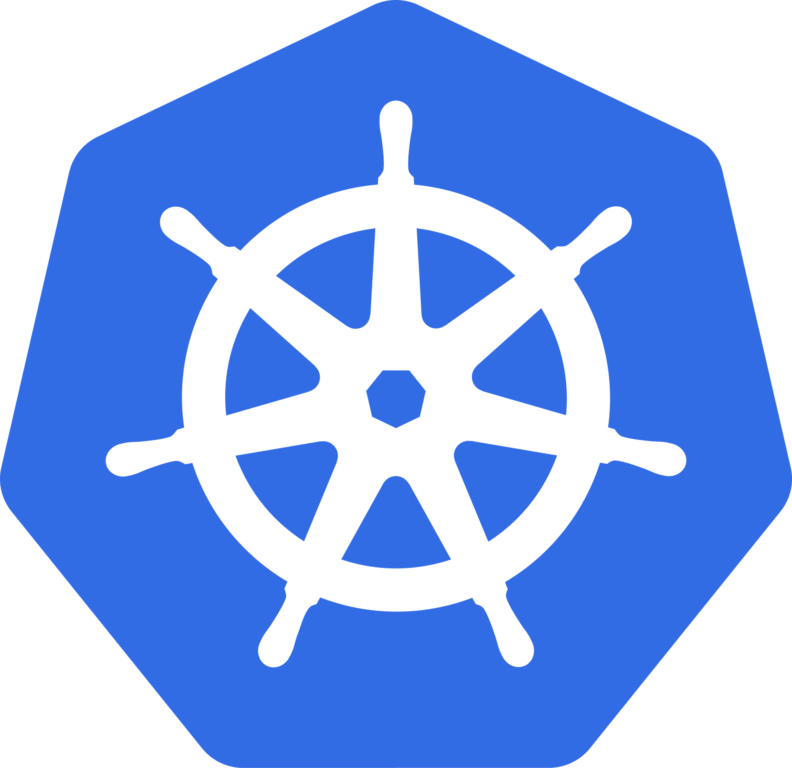


UPLION
Notes:
In summary, UPLION is an ongoing experiment at the intersection of AI and cloud-native technologies. Our objective is to explore and understand the challenges and opportunities of building AI systems that are scalable and resilient. While we are proud of our progress, we recognize that this is a journey of continuous learning and improvement.

Slide 35
Thanks For Watching
Zhang Haoling
YouXam
Wang Ruozhu
sherlockedhzoi
Cai Yiwen
DrinkLessMilkTea
Zhu Yuanchuan
KKChrisYC
Notes:
Thanks For Watching

